Slide 1


Erasmus+ Capacity Building in Higher Education
Strengthening innovative social
entrepreneurship practices for disruptive business settings in Thailand and Myanmar
Projectref.: 609711-EPP-1-2019-1-AT-EPPKA2-CBHE-JP
Duration: 36 Months (15/01/2020-14/01/2023)
February 03-05, 2021

Slide 2

Welcome to day 3

Slide 4
What shall we focus on
SOCIAL IMPACT
BRANDING THE IMPACT
SOCIAL IMPACT ASSESSMENT
BASED ON CASES AND “STORIES”

Slide 5


Social Business Canvas
Social Challenge | Beneficiaries | Beneficiaries Potential Input ü | Partners ü
 | Core Activities ü
Resources ü |  | Desired Future State / Outputs
ü
ü
Beneficiary Perspective

Slide 6
Social Business Canvas
Social Challenge What is the present situation (numbers, scale of problem, geographical area etc.)? What are the root causes of the problem? What are the factors contributing to the problem? Are there any local problem solutions? …… | Beneficiaries Who are your target beneficiaries (age, sex, location, education, work experience, material status, registered in other foundations/social care organizations)? What are their needs? …. | Beneficiaries Potential Input What are your core activities? What core activities are for your beneficiaries? ….. | Partners What social partners do you want to cooperate with? What business partners will you need? What institutional partners will you involve? What know-how will they give you? How will you build relationships with your partners? ….
 | Core Activities What are your core activities? What the core activities are for you beneficiaries? …
Resources What human resources will you need? What material resources will you need? What financial resources will you need? What know-how will you need? …. |  | Desired Future State / Outputs
Beneficiary Perspective
What needs of the target beneficiaries will you satisfy?
What problem(s) will you solve for your target beneficiaries?
What network or ecosystem will be created?
…

Slide 7

LET’S share

Slide 8
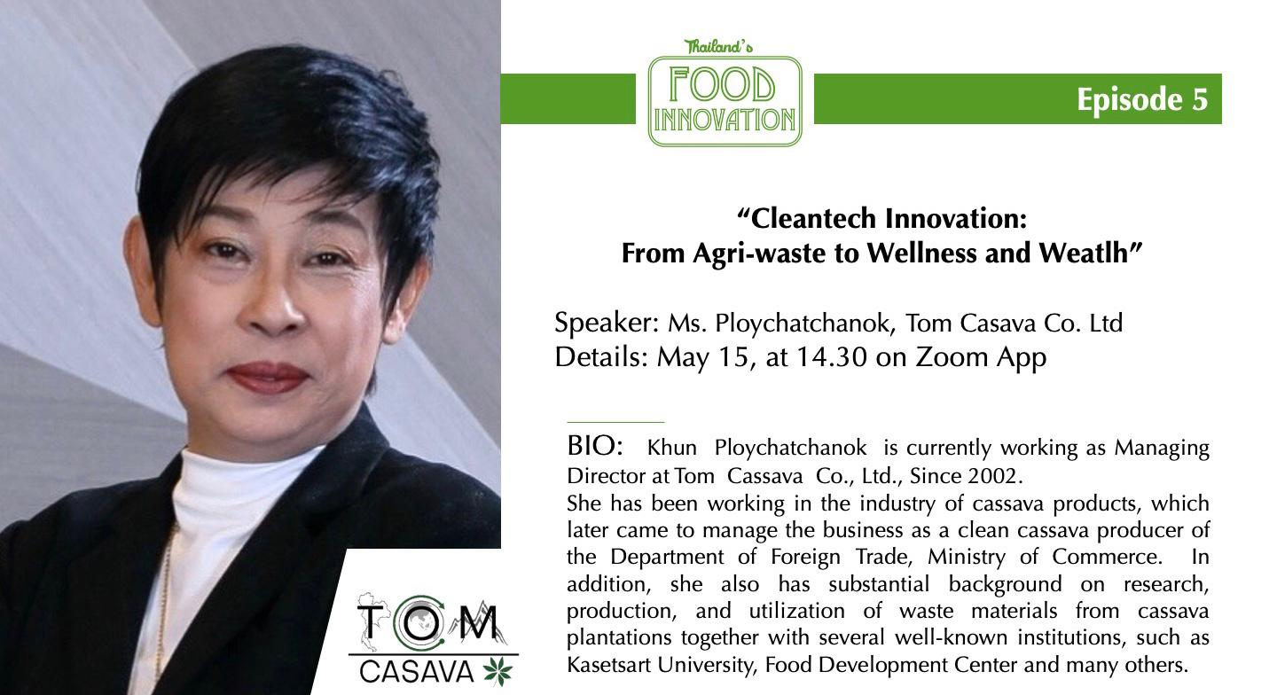
Tom casava case

Slide 9

15 minutes

Slide 10
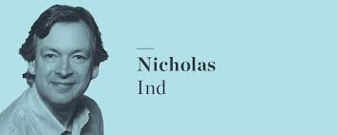
Prof. Nicholas ind

Slide 11
15 minutes

Slide 12

Social impact canvas
A tool to help plan, measure, and account for the changes you want to bring about in the world

Slide 13
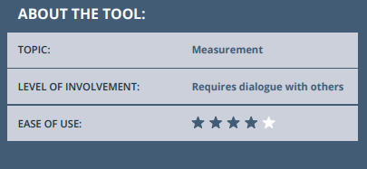

THIS TOOL WILL HELP YOU TO
Build a common understanding of social changes you aspire to
Develop a blueprint for success that will guide your work
Identify measurable indicators to help you stay on course
Agree the steps needed to maximize your social impact
Communicate achievements in clear and compelling ways

Slide 14
Let’s take a step back why do you need to measure the impact of a social business?
Take a look at these examples of socials business and how they impact
1. TOMS Shoes: One for One
TOMS Shoes was moved by the fact that many children in developing countries lack shoes or if they have them, they are not their size nor comply with basic standards towards health and safety. Providing adequate shoes for children is very important and so TOMS: Shoes for Shoes started off. With every pair of shoes, you buy from them they will donate an adequate pair to a child in need. These shoes will enable them to play and go to school safely: improving Health, providing access to Education and building Confidence. TOMS has given over 95 million pairs of new shoes to children in need.
For every 3 euros spent, they donate 1 euro to causes around the world
https://www.toms.com/nl/impact-report-emea.html

Slide 15
Another example
One World Football Project: Transformative Power of Play
Moved by the playing conditions and materials children in developing areas have the team at One World Football Project decided to come up with a durable football, that would work anywhere in the world: tough enough for the roughest landscapes and durable enough to last for years of play. For every ball you buy, they will donate a second ball to organizations that are working with youth in disadvantaged communities worldwide. This will enable the transformative power of play to millions of children who need it most. Their impact is now of over 60 million lives changed.
(form the website) “5% of proceeds from One World Futbol sales goes to provide resources to organizations using play and sport to work with youth in disadvantaged communities worldwide.”
https://www.oneworldplayproject.com/impact/

Slide 16

What should be measured?
TOMS
TOMS has given over 95 million pairs of new shoes to children in need
and donate part of their profits.
ONE WORLD FUTBALL
Their impact is now of over 60 million lives changed.
Donating footballs and proceedings
These numbers aside, what is the aim?
“improving Health, providing access to Education and building Confidence”
“transformative power of play to millions of children who need it most.”
How can you measure these?

Slide 17

In a nutshell, as a social entrepreneur…
The more profit you make, the more positive impact you CAN do.
However, some types of impact are harder to measure (such as improved health or level of confidence, or social transformation) and will need more effort and resources to do so in the long-term.
So, if you start a social business, plan resources (money, time, people) for impact evaluation.

Slide 18

But WHY measuring is important?
Builds TRUST with stakeholders
Increases LOYALTY with consumers
Resulting in more funding, spontaneous partnerships and revenue to further you cause
So again…
The more profit you make, the more positive impact you CAN do.
It is a cyclical process

Slide 19





Impact assessment
According to
The B-Corp Handbook: how you can use business as a Force for Good,
there are 5 areas in which companies can evaluate their impact:
Workers
Community (or Beneficiaries)
Environment
Governance
Customer

Slide 20
What can be measured?
SOME examples
Impact on workers
Share ownership with employees
subsidize professional development and training
Have health and wellness program
Conduct anonymous employee satisfaction surveys
Impact on community
Have a diverse group of owners and employees, including chronically underemployed populations
Purchase from local suppliers or suppliers owned by underrepresented populations
Disclose the names of your suppliers
Commit to donating percentages of revenue
Impact on environment
Use low-impact renewable energy and water-efficient systems
Provide employees with incentives to use alternative commuting options
use recycle and reusable materials
Monitor, record, and reduce your greenhouse gas emissions
Impact on governance
Train your employees in your social/environmental mission
Share with employee's basic financial information
Solicit form external stakeholders feedback about your company’s social and environmental performance
Produce an external annual report detailing your mission-related performance
Impact on customer
Cover your products with consumer warranty
Have publicly known mechanism through which customers can provide product/service feedback, ask questions, or file complains
Create specific increase targets for customer satisfaction

Slide 21
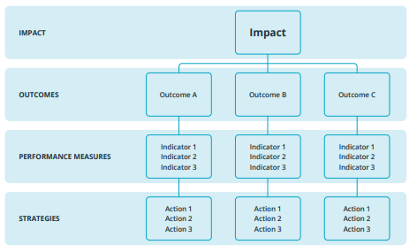
Back to the social impact tool
Every social enterprise exists to achieve social impact. This is central to their mission, to the value they create, and to changes they bring about for society .
Social impact is expressed through outcomes; changes that occur in the lives of people, families, communities or the environment.
A Social Impact Canvas provides a powerful tool that organizations can use to quickly identify the main outcomes and impacts they aspire to and determine what and how to measure their contribution to these.

Slide 22
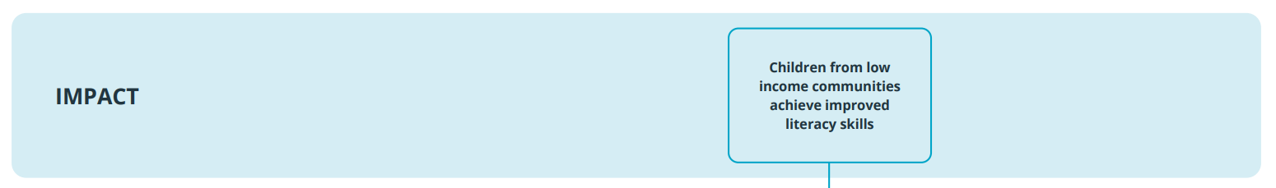
HOW TO USE IT
Step 1
In this case the impact is on the community (beneficiary)
Start off by describing your impact, the end result that your organization is working towards.

Slide 23
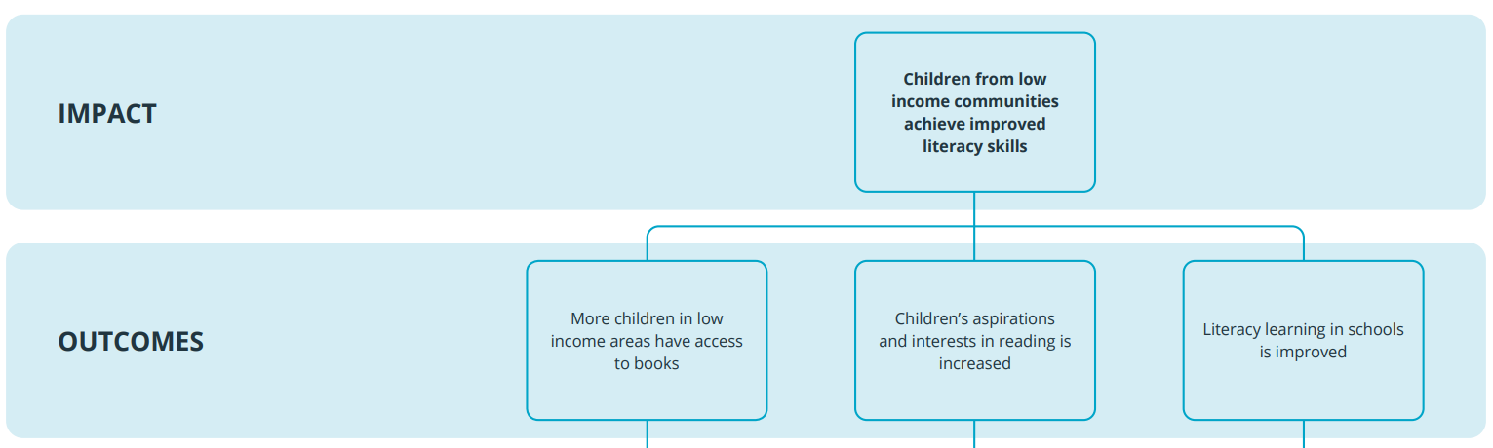
HOW TO USE IT
Step 2
Break down your intended impact into a number of main outcomes. Your outcomes are the changes or effects that are most important to achieving your intended impact.

Slide 24
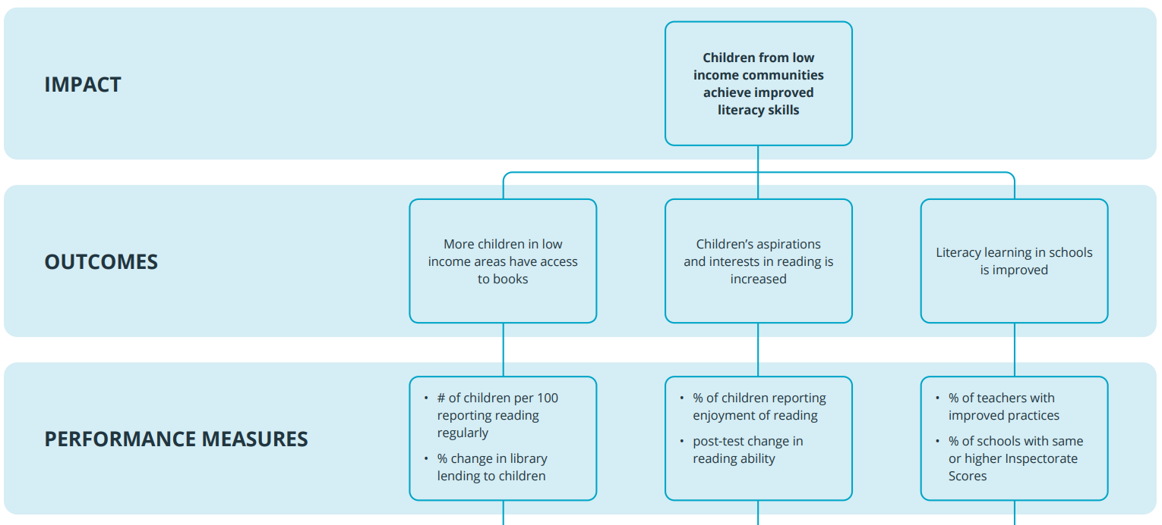
HOW TO USE IT
Step 3
Define the performance measures (or indicators) that will help you quantify and track progress towards your identified outcomes. Your performance measures are the results that you will measure and work towards.

Slide 25
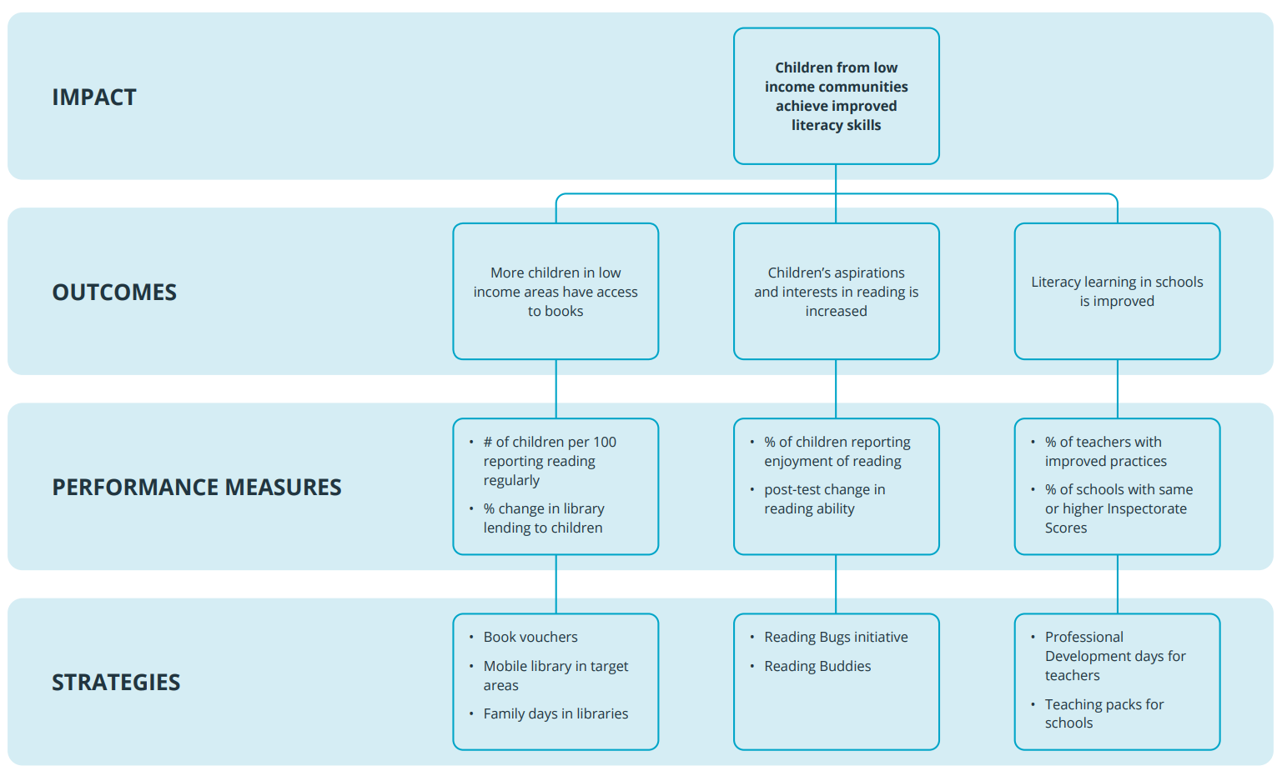
HOW TO USE IT
Step 4
Strategies can be linked to activities and resources of your social enterprise, described in the previous canvas
List the strategies that you will employ. These are the combination of actions necessary to achieve your intended results.

Slide 26

Questions?

Slide 27
Let’s practice identifying impacts
First fill in the IMPACT
Pro TIP: To establish your intended impact, think about the mission of your organization, and the biggest, most broad-ranging change you are working towards.
Always consider preparing your Social Impact Canvas collaboratively, by involving the people you hope will benefit from your work, the team members that will serve them, and the people or groups you are accountable to (such as funders). These different perspectives can help ensure that everyone is clear on what you want to change, how you will bring about change, and Action 1 how you will measure it.
Notes:
CREATE LINK TO MURAL (WHICH MURAL ACCOUNT WILL WE USE? )

Slide 28
Let’s practice describing outcomes
First fill in the OUTCOMES
Pro TIP: To identify your outcomes, think about the immediate changes that are necessary if your end goal (impact) is to be realized. Taken together these will define your success.

Slide 29

15 min
to work on step 1 and 2 on Mural
Q&A

Slide 30
Let’s practice
Setting performance measures
First fill in the PERFORMANCE MEASURES
Pro TIP: Performance measures provide tangible signs (indicators) that you are making progress towards your intended outcomes.
Your measures should be countable, answering questions about the quantity of outcome achieved, such as how many?, how much? or how often? The measures may be an absolute level of change, a percentage, an average, a ratio, or a monetary value.

Slide 31
Let’s practice selecting strategies
First fill in STRATEGIES
Pro TIP: When attempting to come up with strategies, think about the two or three actions that would really move the dial. Ask yourself: what would it take to succeed?

Slide 32

15 min to work on steps 3 and 4 on mural
Afterwards, we shall invite a couple of groups to present

Slide 33


Slide 34
Erasmus+ Capacity Building in Higher Education
Strengthening innovative social
entrepreneurship practices for disruptive business settings in Thailand and Myanmar
Projectref.: 609711-EPP-1-2019-1-AT-EPPKA2-CBHE-JP
Duration: 36 Months (15/01/2020-14/01/2023)

